Slide 1
Sandra Yeye Mesang
Student of the first course in Grodno State Agrarian University (Management)
TRIBAL WEARS.
(Republic of Cameroon)

Slide 2
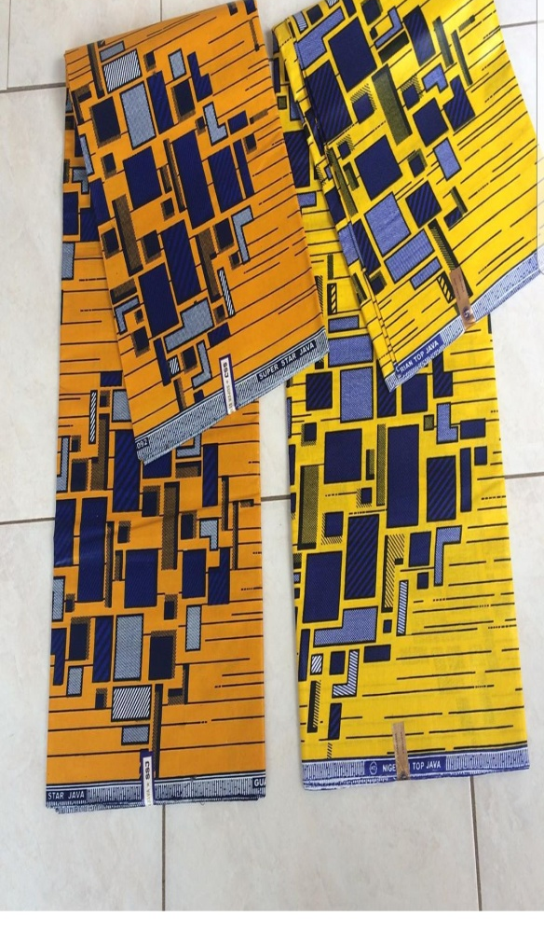

Slide 3
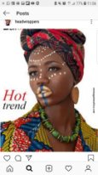

Slide 4
Thanks for attention!

