Slide 1
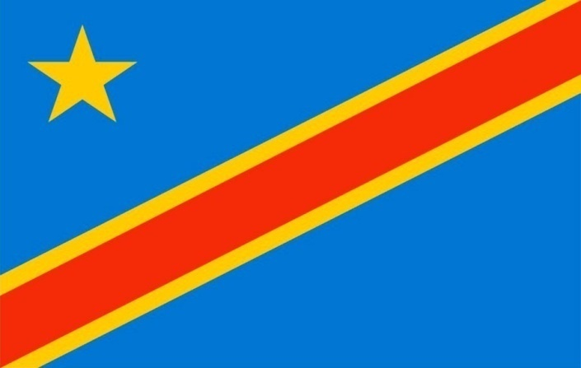
ARUMUGAM ARUNA KARUNAKARAN
GRODNO STATE AGRARIAN UNIVERSITY
Faculty of Economics, specialty management
Course 1
Topic African clothing
Democratic Republic of the Congo

Slide 2
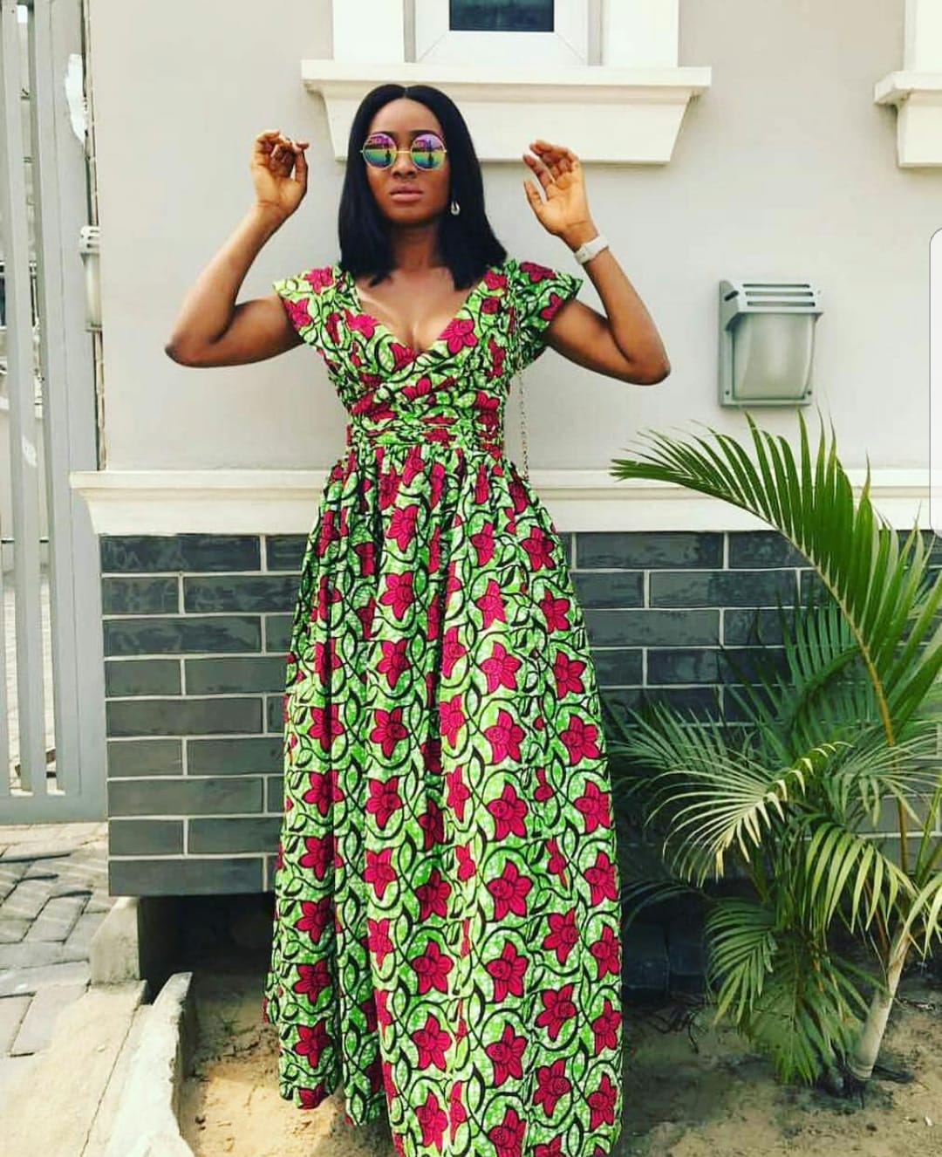
Cuisine de la République Démocratique du Congo: histoire, plats, recettes.
L'histoire
La République démocratique du Congo (RDC) est un État d'Afrique centrale situé à l'équateur, au cœur du continent noir. Jusqu'en 1960, le pays était une colonie de Belgique. Tout près se trouve un pays du même nom, la République du Congo. C'est une ancienne colonie de France.
Ils sont souvent confus.
La RDC est la deuxième (après l'Algérie) en termes de superficie
et la quatrième (après le Nigeria, l'Ethiopie et l'Egypte) en termes
de population sur le continent africain. La RDC compte 26 provinces,
plus de 200 peuples et nationalités, et 242 langues.
La population augmente rapidement, aujourd'hui environ 84 millions de personnes.
La langue officielle est le français.
African clothing is the traditional clothing worn by the people
of Africa. In all instances except rural areas these traditional
garments have been replaced by Western clothing introduced
by European colonialists.
African clothing and fashion is a diverse topic that is able to
provide a look into different African cultures. Clothing varies
from brightly colored textiles, to abstractly embroidered robes,
to colorful beaded bracelets and necklaces.
Since Africa is such a large and diverse continent, clothing
differs throughout each country.

Slide 3
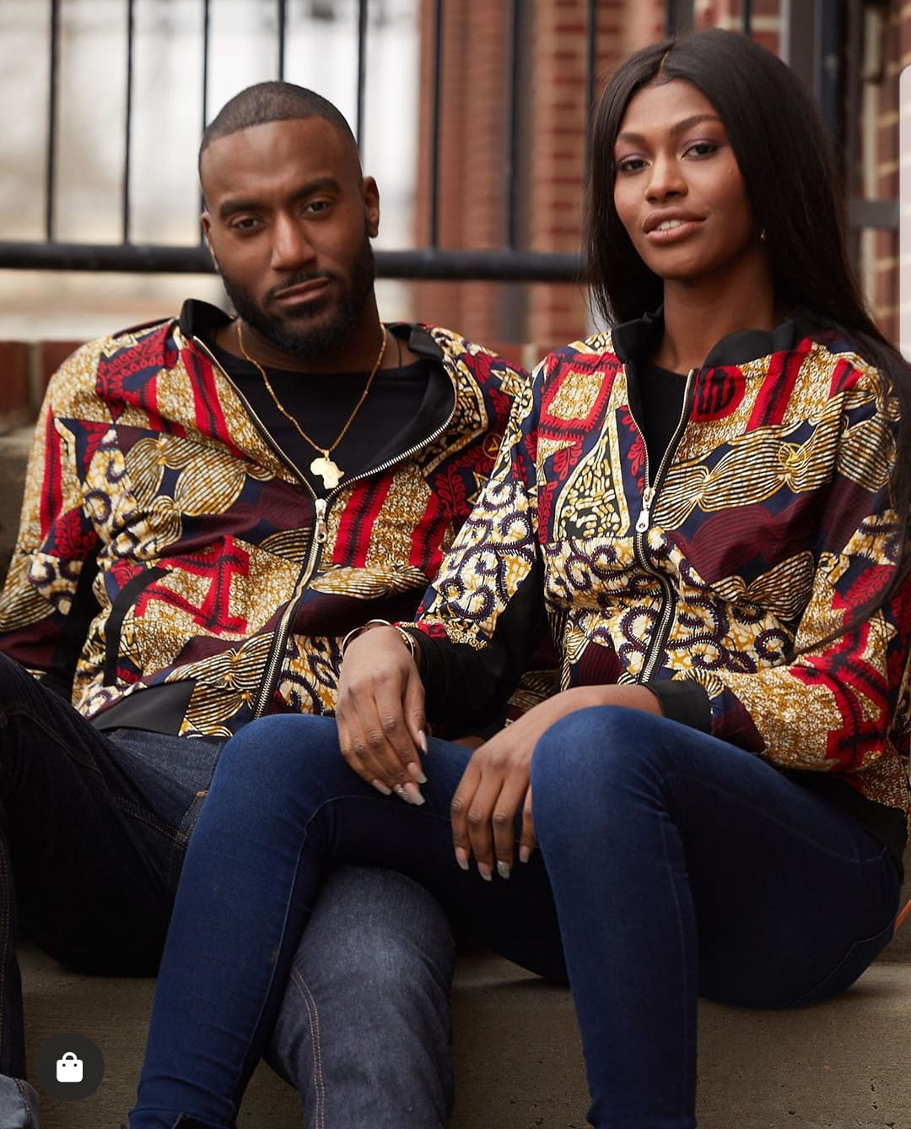
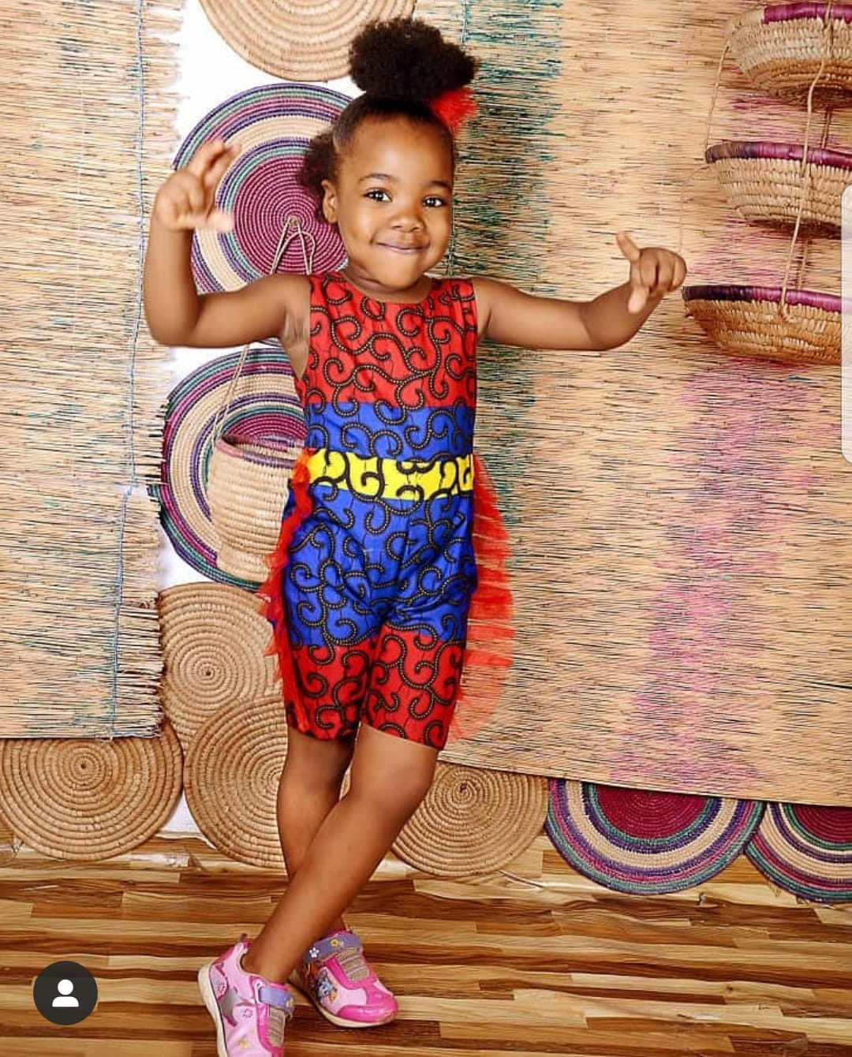
1. Easy to incorporate into your every day style
Over recent years, African fashion has grown in popularity with many fantastic designers and bloggers in this area. The best thing is, you can really make it unique to your sense of style. There's an outfit for every occasion - whether you want to go casual, add color to your work wardrobe or have a friends wedding coming up - you can dress your outfit up or down to create the desired result.

Slide 4
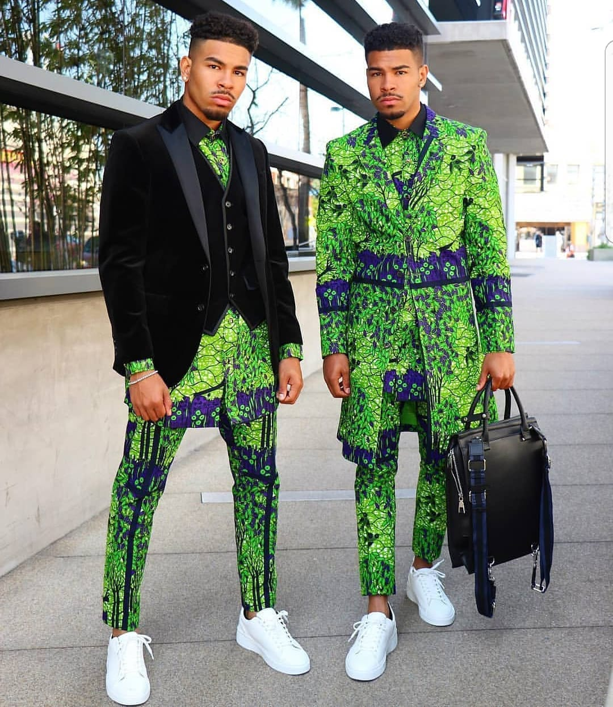
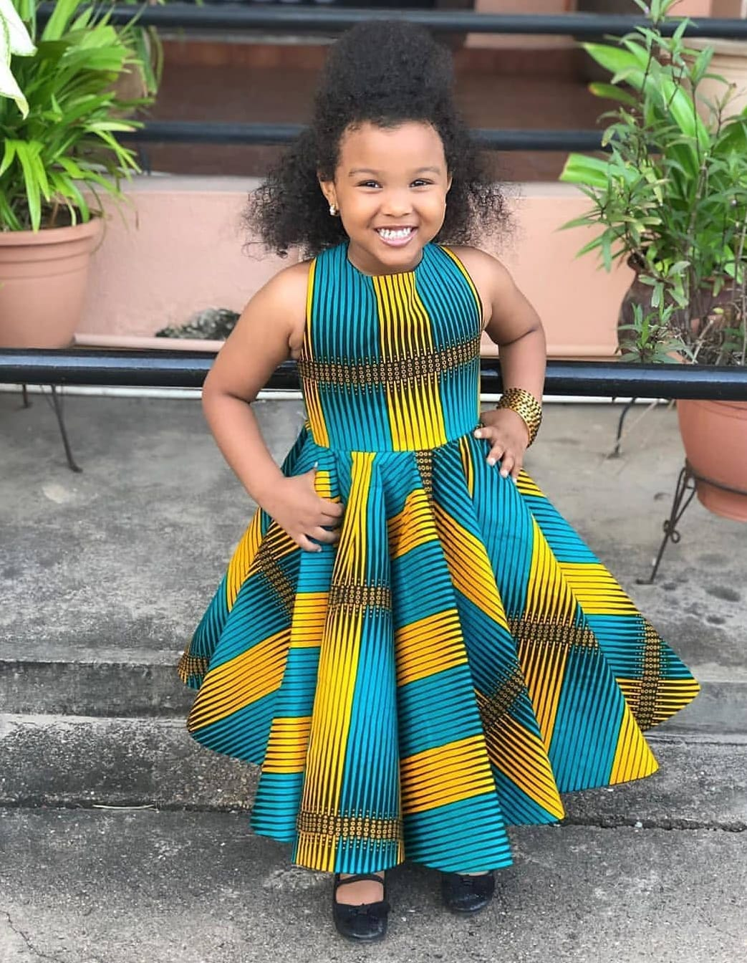
2. Bright, bold and beautiful
One of the best things about African fashion is the array of bold statement colours and prints. You can either make your whole outfit bright, bold and beautiful or just choose a statement piece to incorporate into your look to add a new element of interest to that black blouse. Whether that is through a pair of shoes, stunning necklace or a flowing skirt, the end result is as fantastic as ever.
Perhaps the best thing about the variety of colors is that you can really match it to your personality and play around with the right tones that complement you and your skin tone the best.

Slide 5
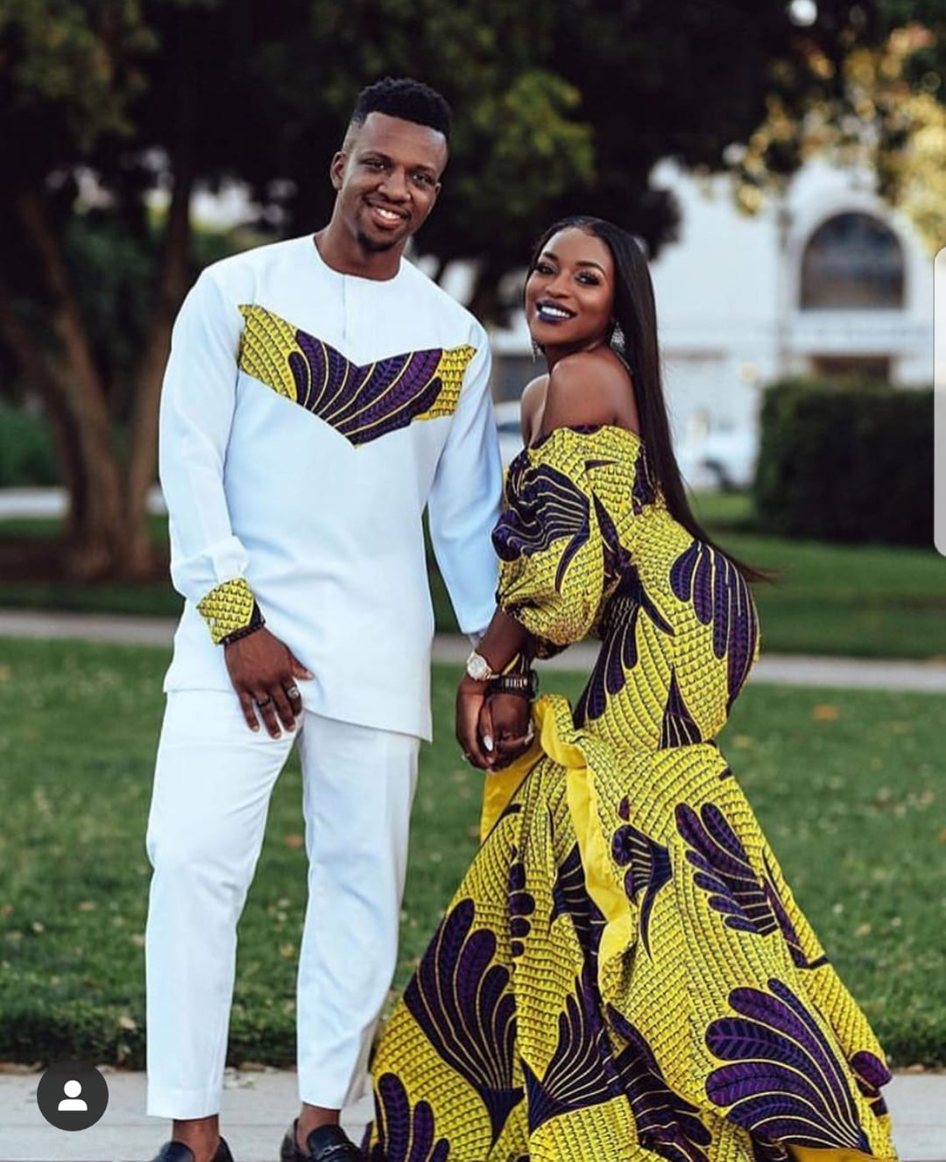
3. Prints Galore
African fashion is a lot more interesting with many different prints to choose from and all with a different meaning.
The prints are used tell stories, proverbs and traditional tales.

Slide 6
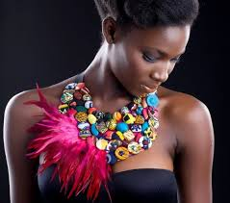
4. Dress to Impress
With African fashion in your wardrobe, there are never ending options to dress up your outfit, whatever the occasion.
For example if you fancy going out in your little black dress, breathe some new life into it by adding a focal point such as a sash, scarf or printed headband.

Slide 7
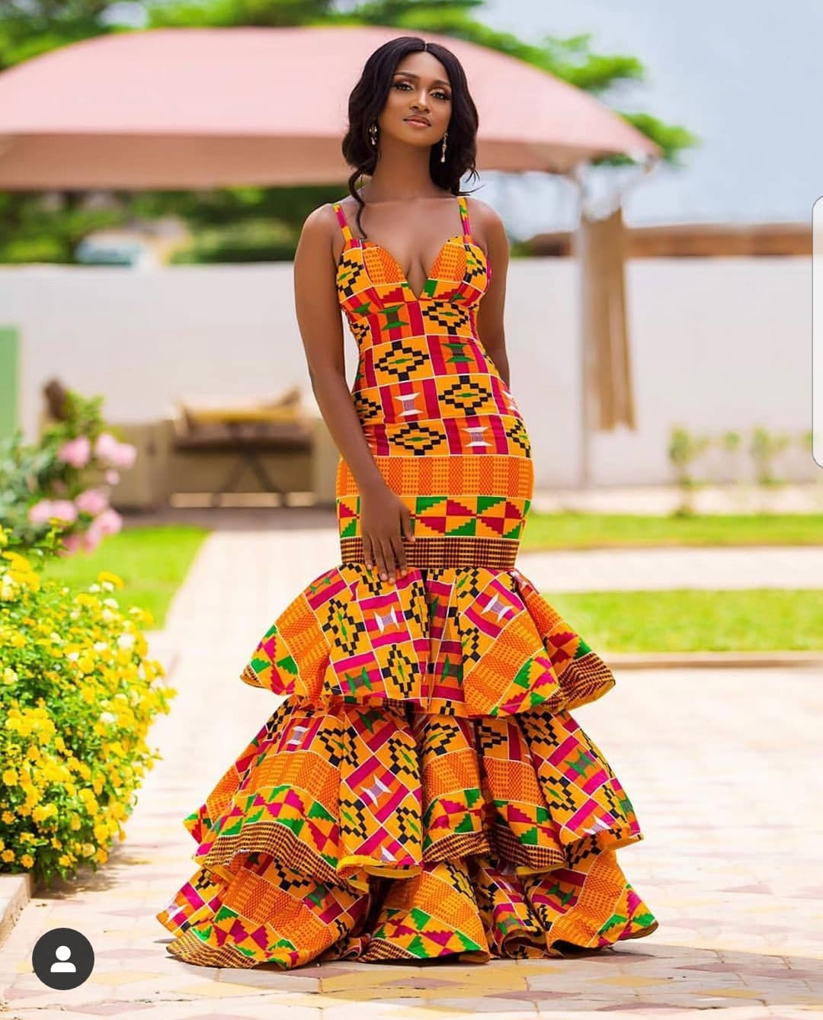
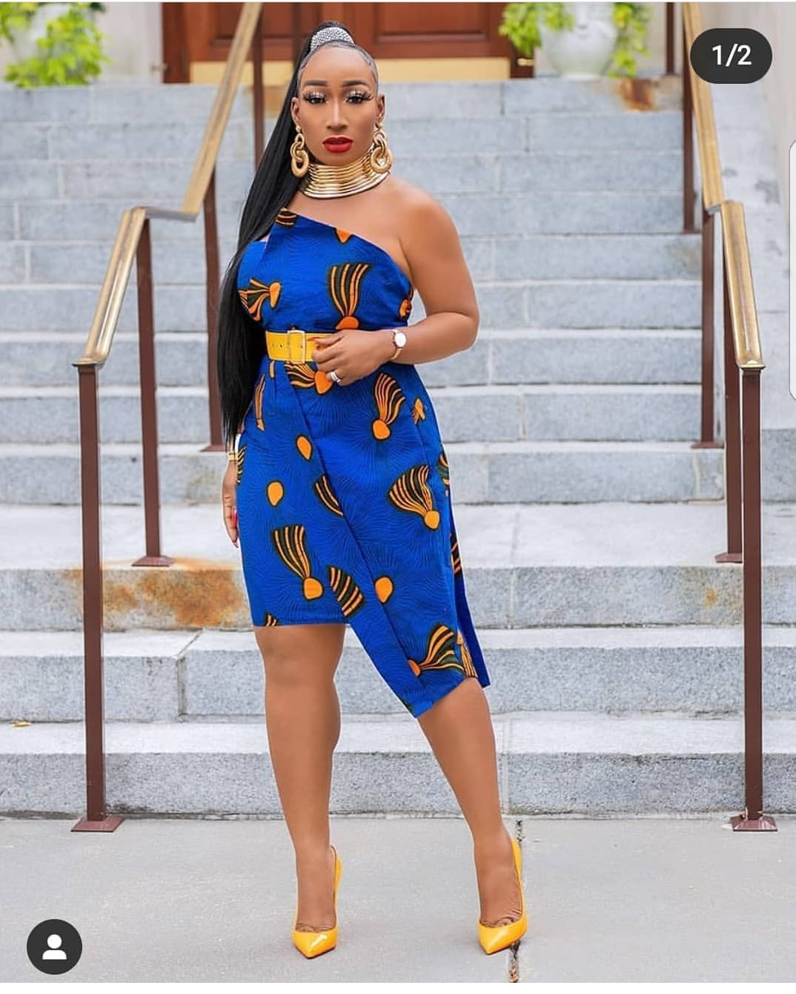
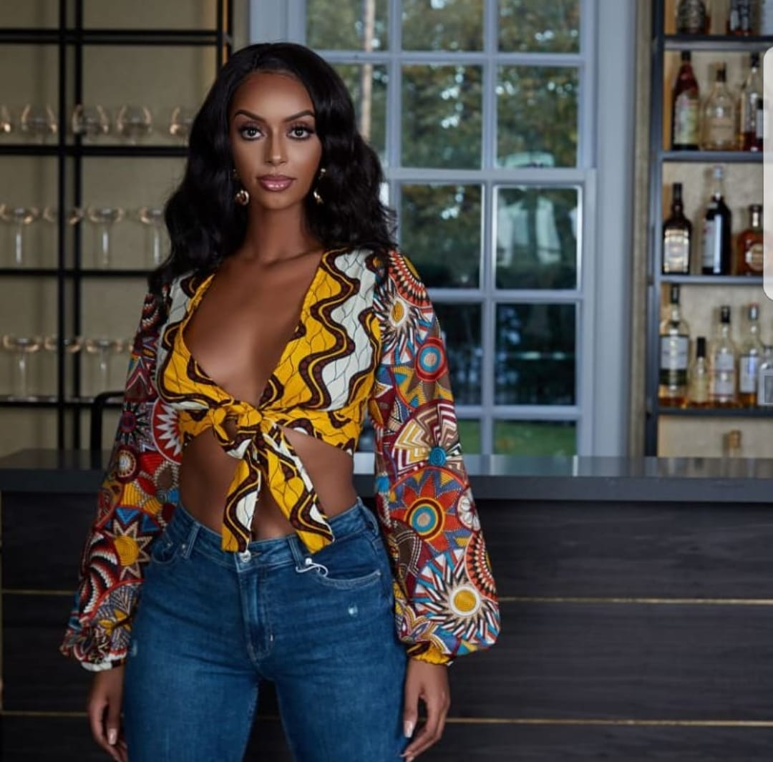
5. Easy to put together
Believe us, there is nothing difficult about African fashion. The trick is to subtly add it into your style as little or as much as your personality and fashion statement allows.

Slide 8
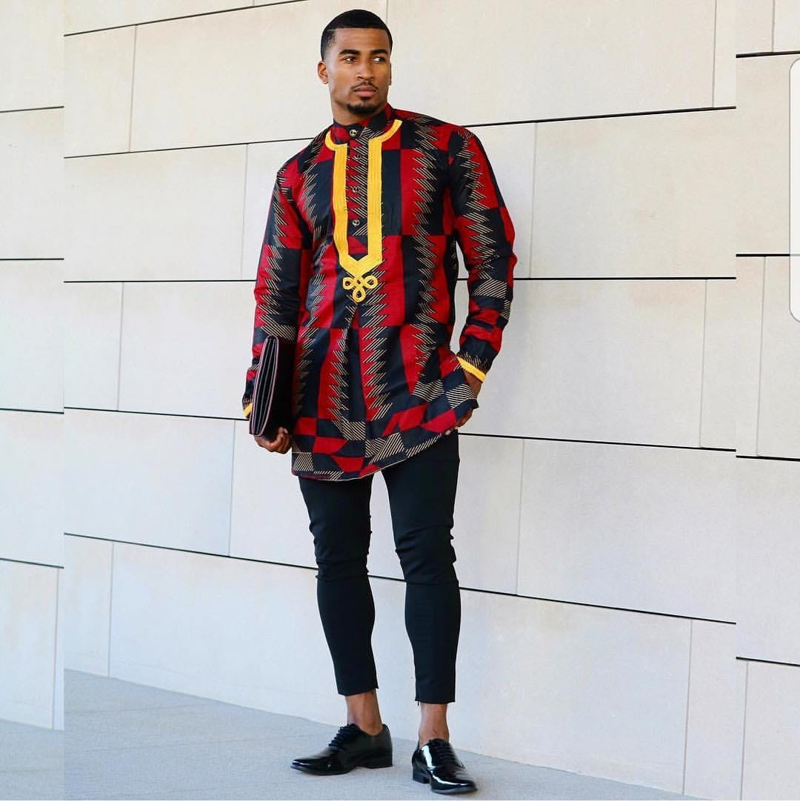
African clothing commonly refers to the traditional clothing worn by the people of Africa.
Different tribes throughout the continent pride themselves on their national dress which they use for ceremonies and special occasions.
There are many varied styles of dress and the type of cloth plays an integral role in fashioning the garment. The fabric often reflects the society in general as well as the status of individuals or groups within that community.
In some instances traditional robes have been replaced or influenced by foreign cultures, like colonial impact or western popular dress code.
The evolution of dress in Africa is very difficult to trace due to the lack of written word and actual historical evidence. Much is pieced together from various sources like traditional robes being handed down to present day tribal members, word of mouth (oral history), theater (masquerades) and from art and artifacts which show sculptural representations of dress.

Slide 9
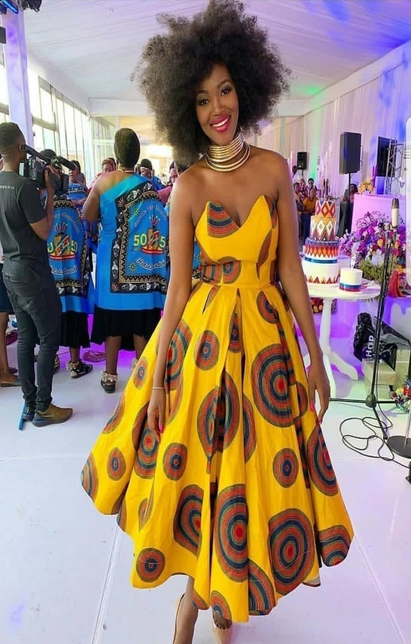
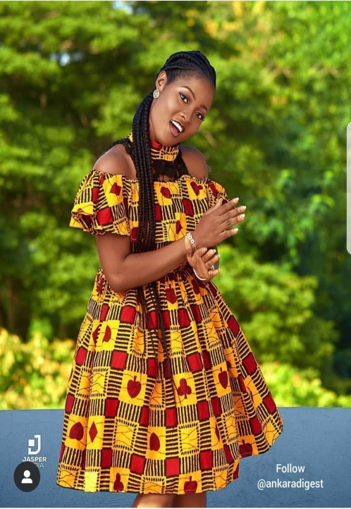
IMAGERY on clothing or traditional attire worn in most African countries has different meanings.
At funerals or weddings, different attires are worn with different symbols.
Chiefs, traditional healers, elderly men and women also wear clothing with different symbols to show their status or positions in society.
A distinctive feature of traditional African dress is its use of festive colours, intricate patterns and figurative symbols to communicate meaning.
These garments are much more than mere adornment.
They are used not just to praise political heroes, to commemorate historical events or to assert social identities, but also as a form of rhetoric – a channel for the silent projection of argument.
In addition to pictorial symbols, colours and writings on the
surface of the cloth, often the cut of a particular African
garment can convey meaning.
Traditional dress for the women
includes various
pieces that signify
age and marital status.

Slide 10
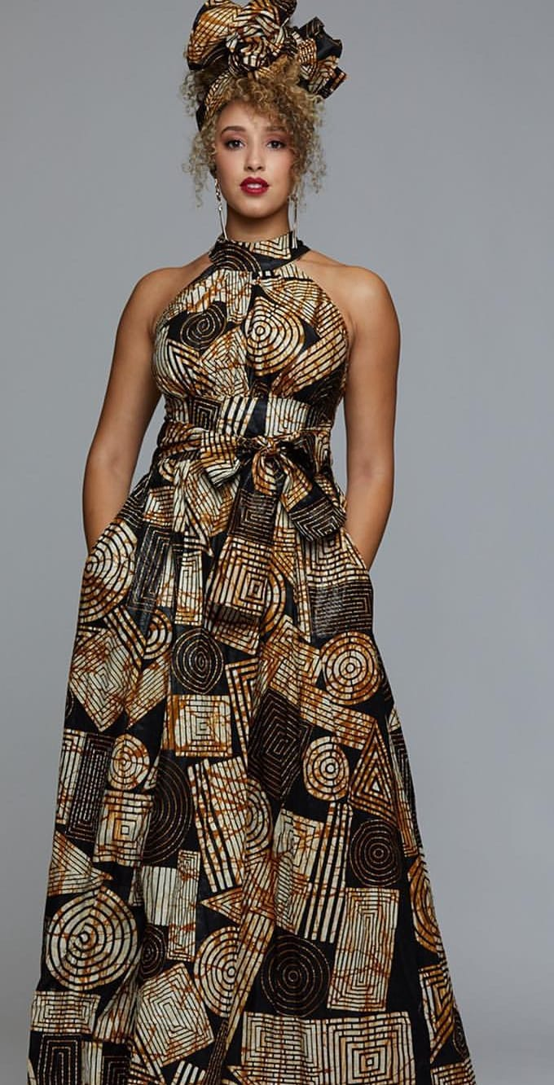
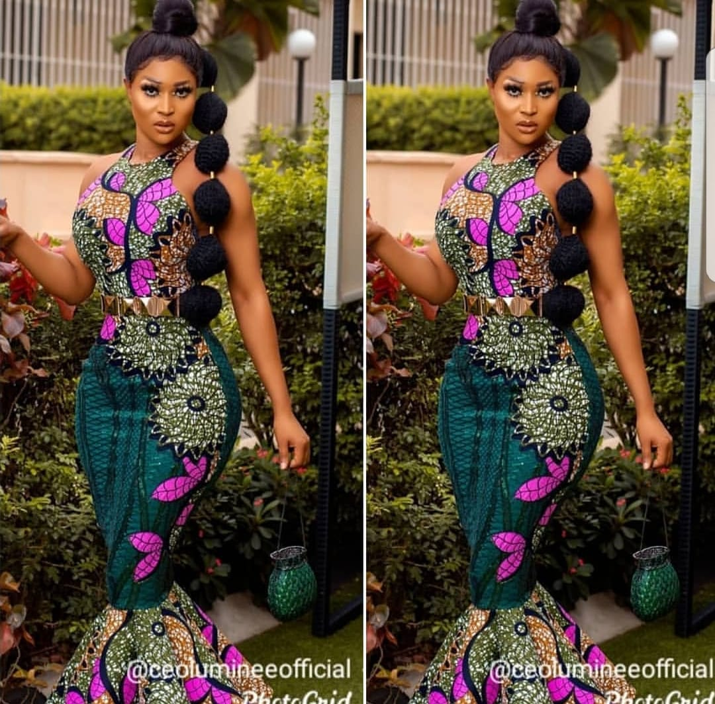
A woman wearing a head-wrap and a long wrap-around
skirt is likely young and unmarried.
If she adds a stretch of cloth around her midsection that is
Often used to carry babies, indicating she is married.
In Congo, just like in other African countries, traditional
dressing is beginning to be recognised although the
country does not have a standard form of this type
of dressing.
Traditionally, this type of dressing included a
wrap-around cloth, headdress and ornaments,
including necklaces, earrings and/or bracelets.
The people of Congo no longer wear these types
of clothing on a regular basis.
Some choose traditional dress for ceremonial or state
occasions, such as Heroes’ Day or Independence Day.

Slide 11
Thanks for attention!

